Slide 1

Analyzing the Fairness of the Scheduling of Epoll
Presenter: Akanksha Dadhich
Guide: Prof. Ashutosh Gupta and
Prof. Mythili Vutukuru
R & D

Slide 2

I/O Multiplexing vs Blocking I/O in Servers
Traditional Blocking I/O
I/O Multiplexing
Server using blocking I/O
Server using I/O multiplexing
Waiting for data..
I/O Multiplexing box
Ready connection detected
Connection 1
Blocked on read()
Connection 1
Handle Ready FD
Connection 2
Waiting....
(Ignored until Conn 1 is done)
Connection 2
Connection 3
Connection 2
Cannot handle Conn 2 & 3
Efficient waiting – no wasted cycles

Slide 3
Introduction to I/O Multiplexing
What is I/O Multiplexing?
  Monitors multiple FDs for events
  Used in servers for multiple connections
System Calls: select, poll, epoll
In server applications (e.g., handling thousands of clients), blocking on one connection would prevent handling others.
I/O multiplexing solves this by allowing the program to:
  Wait for multiple file descriptors (FDs) to become ready.
  Avoid wasting CPU cycles polling each one.
select (1980s)
epoll (2002)
poll
(1997)

Slide 4
How select() Works?
Initialize fd_set (read, write, error)
Add FDs (FD_SET)
Call select(nfds, readfds, ...)
Check ready FDs (FD_ISSET)
Returns updated fd_set
Kernel copies, scans, updates fd_set
Copies fd_set, scans all FDs

Slide 5
Defects of select()
Limited to 1024 FDs (FD_SETSIZE default).
Not scalable
Linear search O(n) for event detection.
Copy Overhead: Entire fd_set copied to/from kernel
Inefficient for idle connections
Data Structure: Uses a fixed-size bit array (fd_set)

Slide 6
How poll() Works?
Monitors FDs using struct pollfd array: events, revents, FDs
Initialize struct pollfd array
Set events (POLLIN, POLLOUT)
Call poll(fds, nfds, timeout)
Check revents for ready FDs
Returns updated array
Kernel copies, scans, updates revents

Slide 7
poll()
No FD limit, scalable in terms of FD count.
Still O(n) due to linear scan of FDs.
Copy Overhead: entire struct pollfd array copied to/from kernel
Inefficient for idle
connections
Data Structure: Uses a dynamic array of struct pollfd (contains FD, events, revents)

Slide 8
What is epoll?
epoll stands for event poll. Unlike poll, epoll itself is not a system call.
It’s a kernel data structure Handles thousands of FDs easily
Efficient, scalable I/O event notification
Edge-triggered and Level-triggered modes
Used in socket programming for non-blocking, asynchronous I/O.
Replaces select/poll with O(1) performance using red-black tree and ready list.
FD X
FD X
FD X
FD X
FD X
FD X
FD X

Slide 9
epoll()
Scalable
No FD limit
O(1) event detection (ready list)
Low copy overhead
Efficient for idle connections

Slide 10
epoll System Calls
epoll_create()
epoll_ctl()
epoll_wait()
int epfd = epoll_create1(0); // Create epoll instance
struct epoll_event event;
event.events = EPOLLIN;
event.data.fd = sockfd;
epoll_ctl(epfd, EPOLL_CTL_ADD, sockfd, &event); // Add socket
struct epoll_event events[10];
int nfds = epoll_wait(epfd, events, 10, -1); // Wait for events

Slide 11
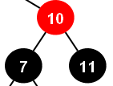
epoll_create: Creating the epoll Instance
epoll_create(int size): Creates an epoll instance, returning a file descriptor (deprecated since Linux 2.6.8).
  size: Hint for kernel on expected FD count (ignored, dynamically resized).
epoll_create1(int flags): Modern version; flags = 0 (same as epoll_create) or EPOLL_CLOEXEC (closes FD on exec).
int epfd = epoll_create1(0);
Pid 483
EPFD
Epoll instance

Slide 12
epoll_ctl: Adding Client Sockets to epoll
epoll_ctl(int epfd, int op, int fd, struct epoll_event *event): Manages FDs in epoll set.
  epfd: File descriptor of epoll instance.
  op: EPOLL_CTL_ADD (register FD), EPOLL_CTL_DEL (deregister), EPOLL_CTL_MOD (modify events).
  event: epoll_event struct with events (bitmask, e.g., EPOLLIN, EPOLLET) and union data.
ready list: Subset of FDs ready for I/O.
struct epoll_event event;
event.events = EPOLLIN;
event.data.fd = client_fd;
epoll_ctl(epfd, EPOLL_CTL_ADD, client_fd, &event);
Pid 483
EPFD
Epoll instance
FD X
FD Y
FD Z

Slide 13
epoll_ctl: Adding Client Sockets to epoll
Each node in the red-black tree is a struct epitem, representing one monitored FD. The structure contains:
  File Descriptor (FD): Stored as epi->ffd.fd
  Event Types: Events the user is interested in (e.g., EPOLLIN, EPOLLOUT) Stored in epi->event.events
  User Data: User-defined data (epoll_event.data, typically a pointer). Stored in epi->event.data
  Ready List Link: A list_head structure (epi->rdlink) to link this epitem into the ready list when events occur.
  Red-Black Tree Metadata: struct rb_node for tree links (left, right, parent)
Pid 483
EPFD
Epoll instance
FD X
FD Y
FD Z

Slide 14
epoll_wait: Waiting for Events
epoll_wait(int epfd, struct epoll_event *evlist, int maxevents, int timeout): Blocks until FDs are ready.
  epfd: Identifies epoll instance.
  evlist: Array of epoll_event structs, filled with ready FDs.
  maxevents: Size of evlist array.
  timeout: 0 (non-blocking), -1 (block forever), or positive (ms timeout).
Returns: -1 (error), 0 (timeout), or positive (number of ready FDs).
Pid 483
Epoll_wait()
EPFD
Ready List Returned
FD X
Ready list
FDZ
FDX
FD Y
FD Z
Epoll instance

Slide 15



But is epoll fair?
Web Servers & Proxies
Financial Trading Systems
Real-Time Chat

Slide 16
What is Fairness in epoll?
Fairness refers to the equal treatment of two connections (Persistent and Non-Persistent connections) during scheduling by the epoll mechanism.
Fair means no consistent preference is shown to either connection type.
The order of scheduling should be random or balanced over time.
Both connections (Persistent and Non-Persistent connections) should have equal chances to be processed first.

Slide 17
Flow
Socket Buffer & epoll
  NIC receives packets
  Raises hardware interrupt (if not in NAPI polling mode)
  NIC DMA packets into the RX Ring Buffer
  Packet is enqueued to the socket’s buffer on the target CPU.
  Trigger sk_data_ready() callback → wakes up epoll.
Packet Arrival
  Kernel switches to NAPI polling
  Kernel computes 5-tuple hash (software) to determine CPU core
  Packet is forwarded to the target CPU core
NAPI Polling & Core Assignment

Slide 18
What Does NAPI Do?
NAPI (New API) is a Linux kernel mechanism to handle high-speed packet processing efficiently.
Hybrid Interrupt + Polling Model
  Initial Interrupt:
  When the first packet arrives, the NIC raises a hardware interrupt to notify the CPU.
  Switch to Polling:
  The kernel disables further interrupts for that RX queue and switches to polling mode.
  The NAPI poll loop processes packets in bulk from the RX ring buffer.
  Exit Polling:
  When the buffer is empty, re-enable interrupts.

Slide 19
Why NAPI Polling?
Reduce Overhead:
Under high traffic, interrupts (per-packet notifications) overload the CPU.
Polling batches packets, improving throughput.
Without NAPI: 10,000 packets → 10,000 interrupts.
With NAPI: 10,000 packets → 1 interrupt + 1 polling loop.
Flow Summary
Packet → NIC → RX Ring Buffer (Queue X) → NAPI ID X → CPU Core X → Socket Buffer (Core X)

Slide 20
After sk_data_ready() ?
Is `ep->ovflist` active?
Packet
Received
sk_data_ready() →
ep_poll_callback()
YES
Add to `ovflist` via `chain_epi_lockless()`(atomic)
NO
Add to `rdllist` via `list_add_tail_lockless()`
Wake up userspace (if blocked in `epoll_wait()`)

Slide 21
After sk_data_ready() ?
Userspace calls `epoll_wait()` → `ep_send_events()`
Lock `ep->mtx` to block concurrent modifications
Merge `rdllist` + `ovflist` into `txlist` (temporary list)
Process `txlist`: For each event:
Re-check readiness (ep_item_poll())
Copy to userspace
Unlock `ep->mtx`
Userspace processes events (e.g., reads data)

Slide 22
After sk_data_ready() ?
ep_send_events() starts:
rdllist = [A, B],
ovflist = inactive.
New event C arrives → added to ovflist (now active).
ep_send_events() merges
ovflist → txlist = [A, B, C, D].
T1
T3
T5
T0
T2
T4.
rdllist moved to txlist →
txlist = [A, B]
rdllist = empty.
New event D arrives → added to ovflist
ovflist reset to inactive. New events go to rdllist.

Slide 23
The Role of chain_epi_lockless()
When a socket becomes ready (e.g., data arrives), sk_data_ready() invokes ep_poll_callback().
static int ep_poll_callback(wait_queue_entry_t *wait, ...) { // 1. Check if events are being transferred (ovflist active) if (READ_ONCE(ep->ovflist) != EP_UNACTIVE_PTR) { // Use lockless atomic ops to add to ovflist chain_epi_lockless(epi); } else { // Add to rdllist (lockless) list_add_tail_lockless(&epi->rdllink, &ep->rdllist); } // 2. Wake up userspace blocked in epoll_wait() wake_up(&ep->wq); }

Slide 24
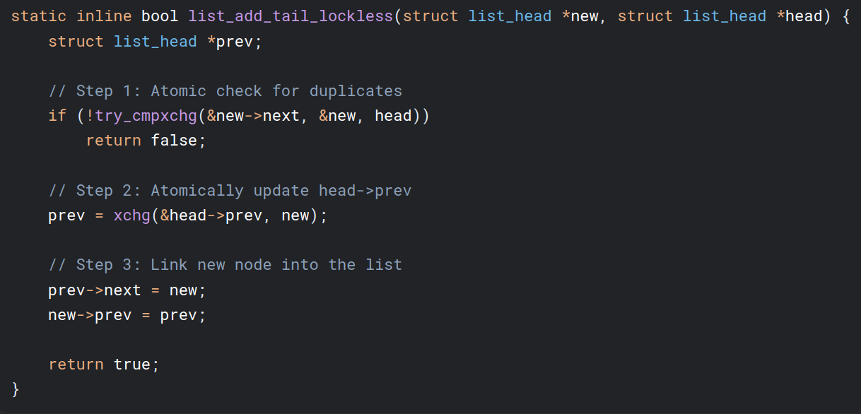
The Role of list_add_tail_lockless()
This function ensures atomic, lockless additions to ready_list

Slide 25
The Role of chain_epi_lockless()
This function ensures atomic, lockless additions to ovflist:
cmpxchg: Ensures only one thread can mark epi->next as "in-use".
xchg: Atomically appends the event to ovflist (no locks required).
static inline bool chain_epi_lockless(struct epitem *epi) { // 1. Check if epi is already in ovflist (fast path) if (epi->next != EP_UNACTIVE_PTR) return false; // 2. Atomic compare-and-swap: only one thread succeeds if (cmpxchg(&epi->next, EP_UNACTIVE_PTR, NULL) != EP_UNACTIVE_PTR) return false; // 3. Atomically update the tail of ovflist epi->next = xchg(&ep->ovflist, epi); return true; }

Slide 26
Userspace Calls epoll_wait()?
This triggers ep_send_events(), which transfers events from the kernel to userspace.
static int ep_send_events(struct eventpoll *ep, ...) { // 1. Lock to prevent concurrent modifications mutex_lock(&ep->mtx); // 2. Atomically move rdllist + ovflist to a temporary list (txlist) ep_start_scan(ep, &txlist); // 3. Iterate over txlist and copy events to userspace list_for_each_entry_safe(epi, tmp, &txlist, rdllink) { revents = ep_item_poll(epi, ...); // Re-check if the event is still ready copy_to_user(events, revents); // Send to userspace } // 4. Release lock mutex_unlock(&ep->mtx); }

Slide 27
The Role of ep_start_scan()
Merges rdllist and ovflist into txlist:
static void ep_start_scan(struct eventpoll *ep, struct list_head *txlist) { // 1. Move rdllist to txlist rdllist → txlist (now empty) list_splice_init(&ep->rdllist, txlist); // 2. Atomically move ovflist to txlist WRITE_ONCE(ep->ovflist, EP_UNACTIVE_PTR); smp_mb(); // Memory barrier while (epi = xchg(&ep->ovflist, NULL)) { // Append ovflist events to txlist list_add_tail(&epi->rdllink, txlist); } }

Slide 28
Experiments & Results

Slide 29
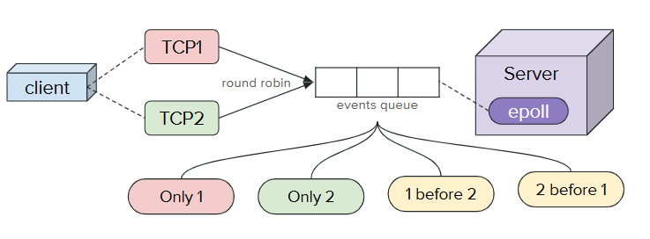
Experiment 1
Setup
  Server sets up socket
  Registers server FD to epoll
  Server accepts and registers client sockets and uses epoll to monitor FDs.
  Client sends 2 TCP connections (Socket 1, Socket 2) in round-robin;
Event Cases:
  Only Socket 1: fd1 ready, fd2 not ready.
  Only Socket 2: fd2 ready, fd1 not ready.
  Socket 1 before Socket 2: Both ready, fd1 processed first.
  Socket 2 before Socket 1: Both ready, fd2 processed first.

Slide 30
Experiment 1
Client
TCP1
2 before 1
Server
1 before 2
Only 1
Only 2
Both connected
fd
epoll
TCP2

Slide 31
Sending different KB of 60B Packets
Each value is averaged over 20 runs.

Slide 32
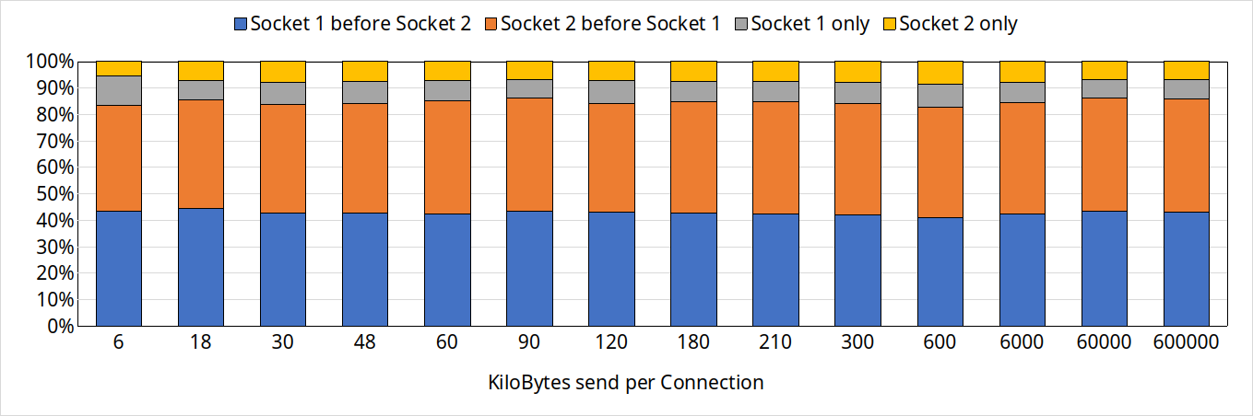
Sending different KB of 60B Packets
Each value is averaged over 20 runs.

Slide 33
Sending 1 million packets of 240B for different time intervals

Slide 34
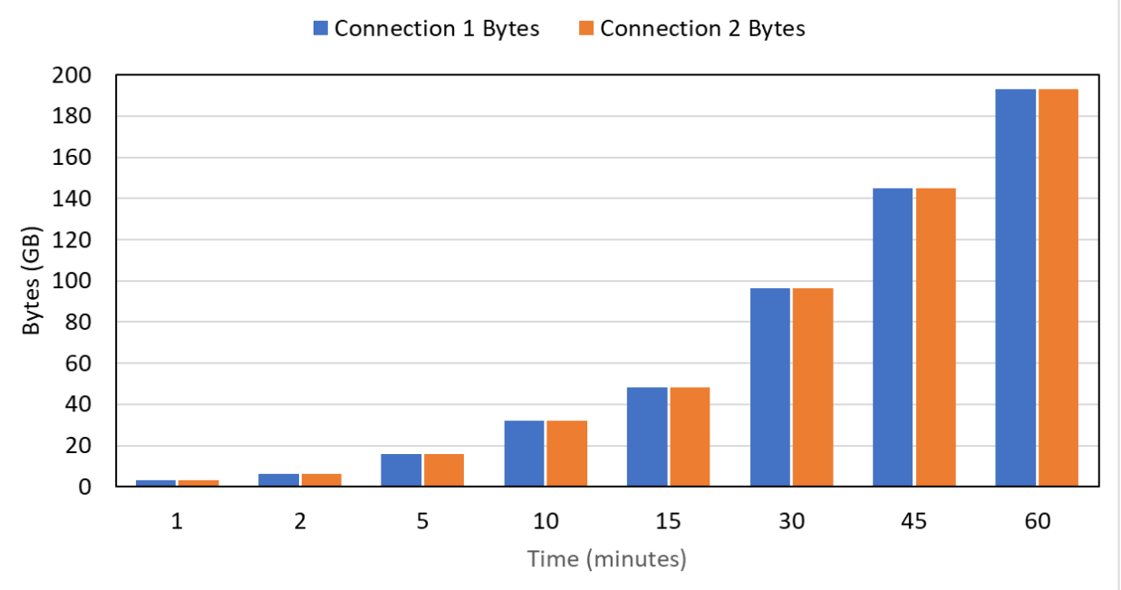
Sending 1 million packets of 240B for different time intervals

Slide 35
Changing per packet size and running for 1 hour
Send 16 million packets for 1 hour of different packet sizes
Each value is averaged over 5 runs.

Slide 36
Changing per packet size and running for 1 hour
Send 16 million packets for 1 hour of different packet sizes
Each value is averaged over 5 runs.

Slide 37
Changing per packet size and running for 1 hour
Send 16 million packets for 1 hour of different packet sizes
Each value is averaged over 5 runs.

Slide 38
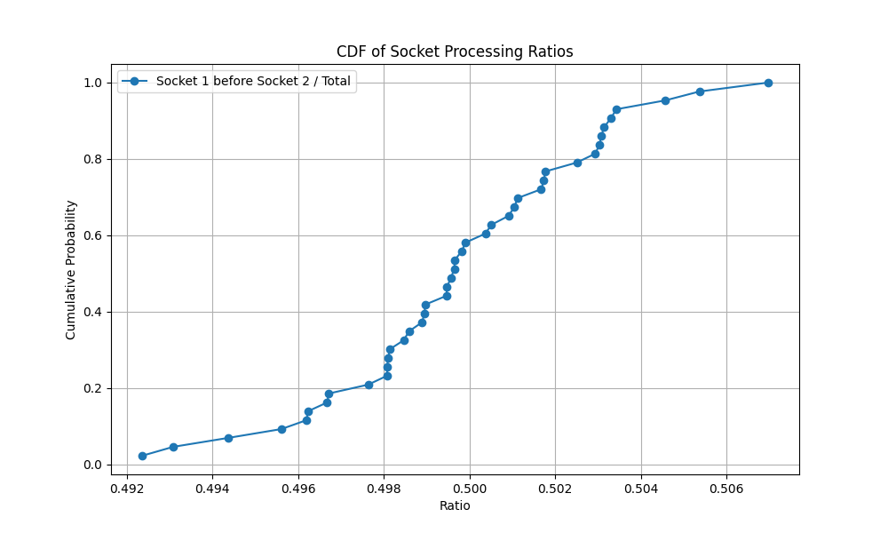
Sending 16 million 240B packet for 15 minutes (45 runs shown here)

Slide 39
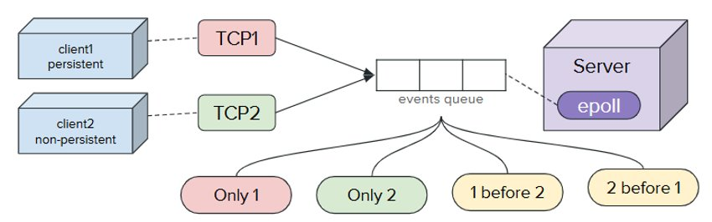
Experiment 2: Analyzing Bias in epoll for Persistent vs. Non-Persistent Connections
  Setup
    Server uses epoll to handle two clients
    Client 1: Persistent connection (keeps socket open).
    Client 2: Non-persistent connection (Frequently creating new connection).
  Goal: Check for bias in event processing order.
  Event Cases:
    Case 1: Only persistent connection active.
    Case 2: Only non-persistent connection active.
    Case 3: Both active, persistent chosen first.
    Case 4: Both active, non-persistent chosen first.

Slide 40
Experiment 2
persistent
TCP1
2 before 1
Server
1 before 2
Only 1
Only 2
Both connected
fd
epoll
non persistent
TCP2

Slide 41
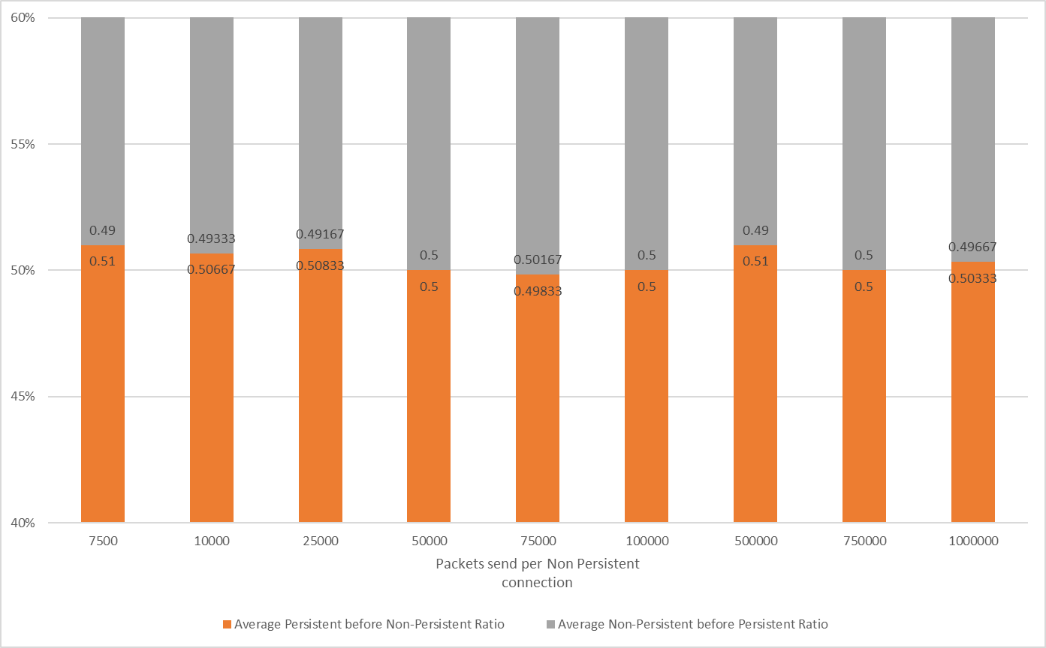
Packets send in each Non persistent connection

Slide 42
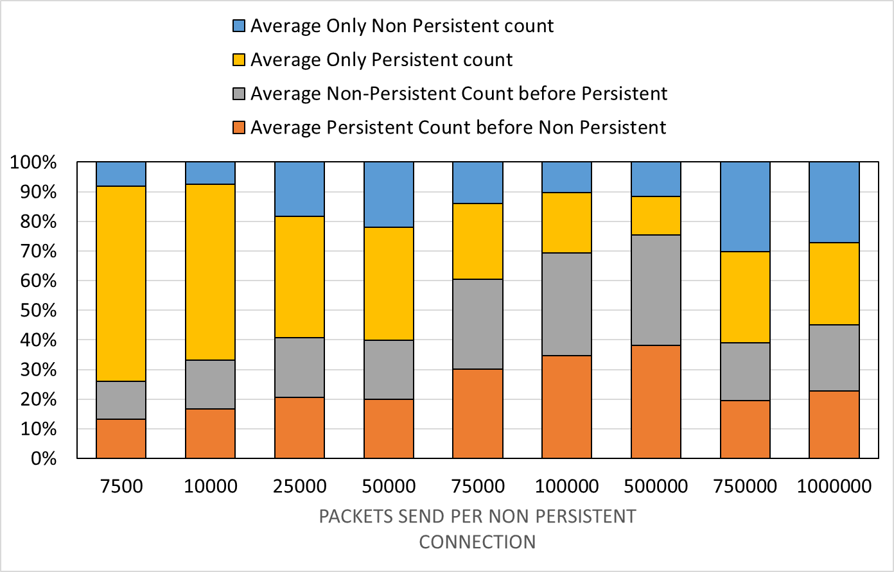
All four ratio vs Packets(1024B) send in each Non persistent connection

Slide 43
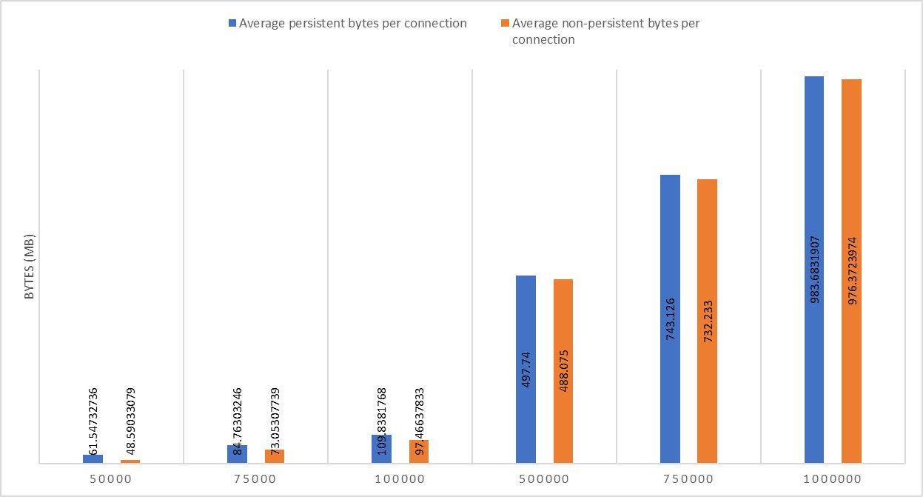
Bytes send vs Packets send in each Non persistent connection

Slide 44
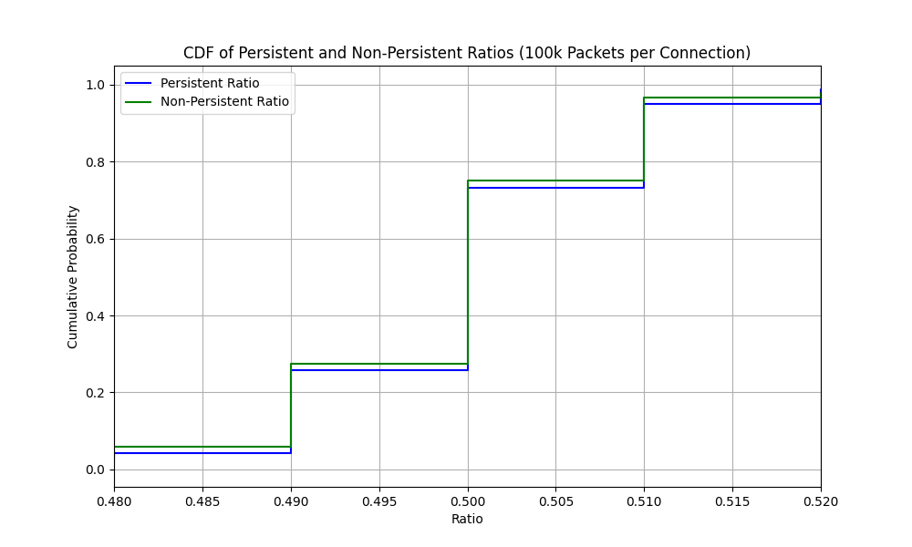
CDF of Persistent before Non Persistent and vice versa

Slide 45
Conclusion
Explored I/O Multiplexing
Three system call select(), poll(), epoll()
Observed the nearly 50/50 split in first experiment
Fairness was held under different test parameters for experiment 1.
The ratio of Persistent-before-Non-Persistent is slightly above 0.5
epoll is generally fair for both types of experiments but there may be a subtle preference towards Persistent connections.

Slide 46
Conclusion

Slide 47
References
https://fasterdata.es.net/network-tuning/
https://blog.packagecloud.io/monitoring-tuning-linux-networking-stack-receiving-data/
https://copyconstruct.medium.com/the-method-to-epolls-madness-d9d2d6378642
https://man7.org/linux/man-pages/man2/epoll_create.2.html
https://man7.org/linux/man-pages/man2/epoll_ctl.2.html
https://github.com/torvalds/linux/blob/master/fs/eventpoll.c

